Slide 1
Developing a 1D Axisymmetric Flow Profile in Liquid Mercury with Eddy Current Flow Meters and Deep Neural Networks
Presented by Grayson Gall
Thanks to Cornwall Lau
July 25, 2022

Slide 2
Outline of today’s talk
Motivation and introduction to this eddy current flow meter (ECFM) project
Modeling setup for velocity profile prediction from ECFM measurements and model validation.
Brief overview of Experimental Setup
Model verification and validation results

Slide 3
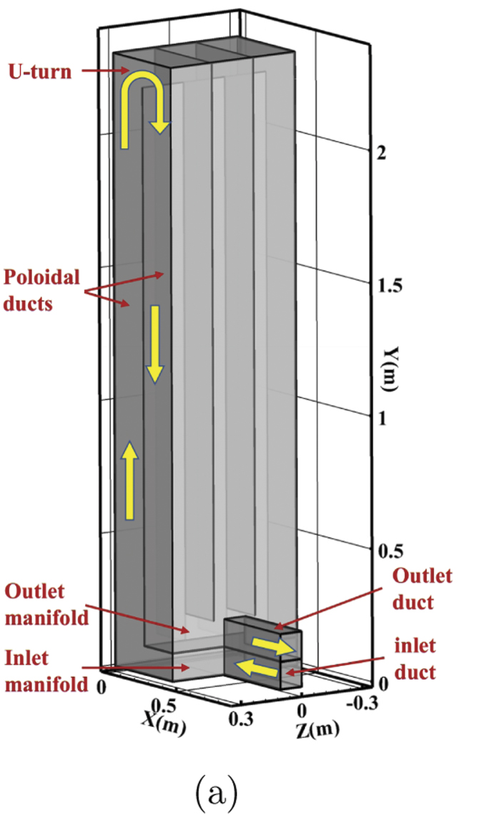
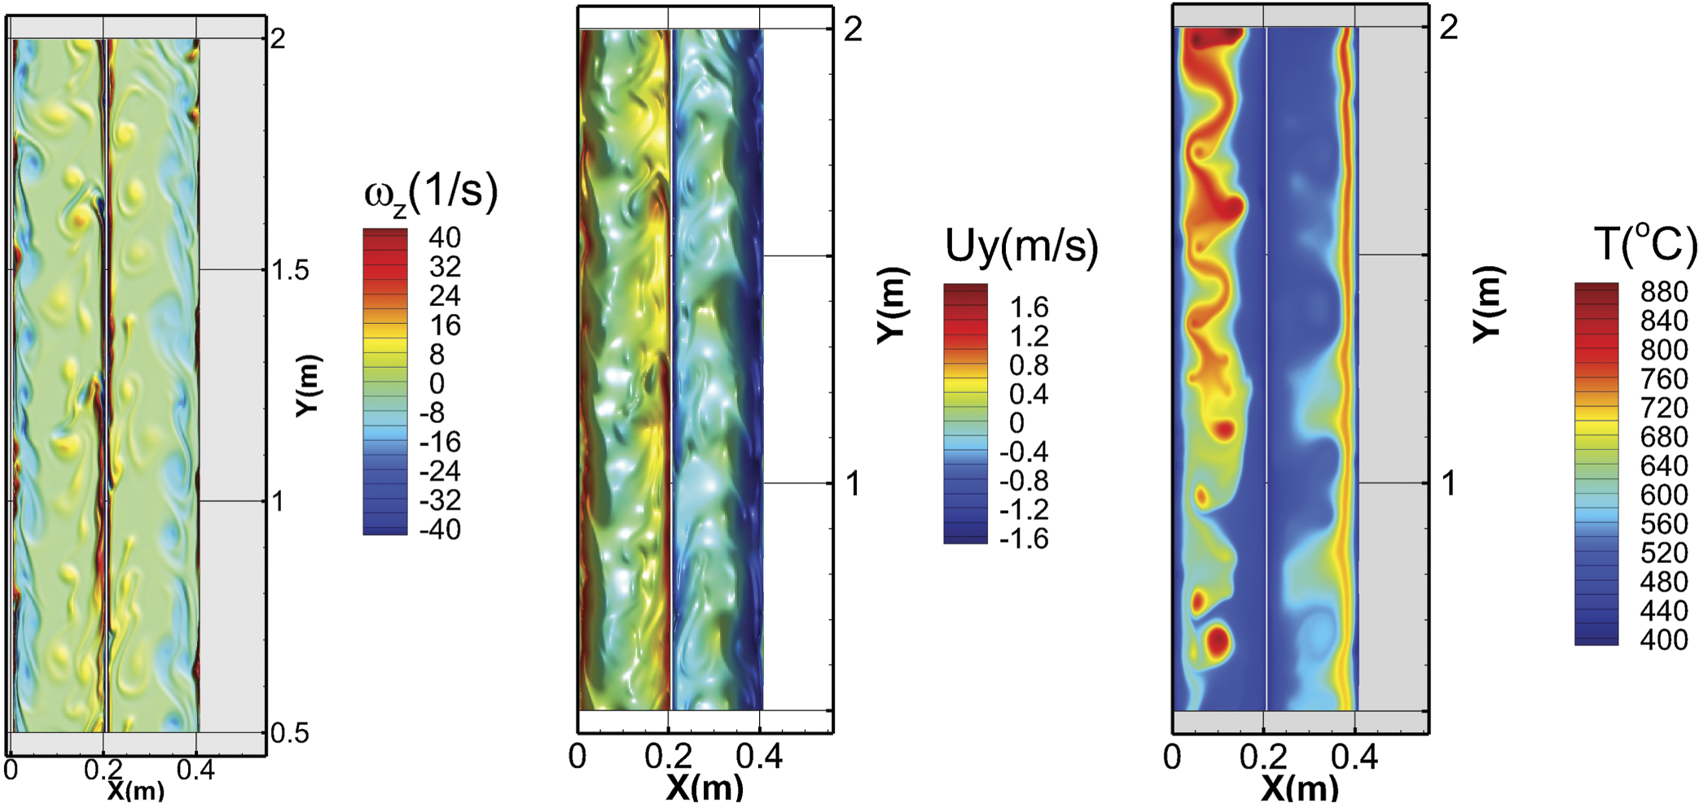
Liquid metals are used or proposed for reactor applications
Advantages include high thermal conductivity and use in high temperature systems for thermal efficiency such as reactors
Advanced fission reactor
Examples include liquid lead and
liquid sodium
Fusion reactor
Blankets such as PbLi or FLiBe
Plasma facing components
(liquid lithium etc.)
Vortex structure in PbLi blanket poloidal duct simulation
Chen, Smolentsev NF 2022

Slide 4
Liquid metal flow rate measurements in fission and fusion reactors
Flow profile measurements are desired for model validation, control and safety; flow meters are an active field of research in reactors mostly due to measurement issues with high temperature, corrosive liquid metals containing radionuclides
Visible and pressure-based flow meters: most liquid metals are opaque to visible light and differential-pressure meters have difficulty at high temperature and with corrosive liquids
DC magnetic flow meters: commonly used for electrically conductive liquid metals
Works! and is relatively reliable; can be bulky, permanent magnets
AC flow meters: example eddy current flow meters (ECFM)
Ultrasonic flow meters: measure flow profiles, but challenging at high temperatures and in corrosive materials
Piezoelectric materials are required to launch ultrasonic frequencies
Summary based on discussion and literature search done by Cornwall Lau

Slide 5
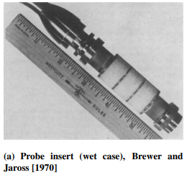
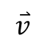
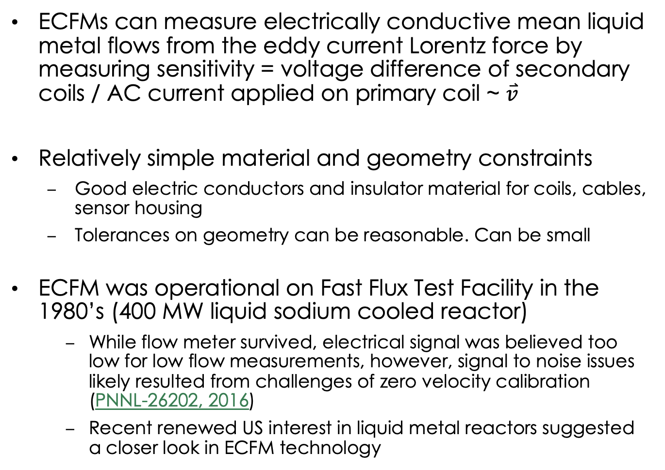
Basic ECFM theory
Secondary
coil
Primary
coil
Secondary
coil
ECFMs can measure electrically conductive mean liquid metal flows from the eddy current Lorentz force by measuring sensitivity = voltage difference of secondary coils / AC current applied on primary coil ~ $\overset{⃑}{v}$
Relatively simple material and geometry constraints
Good electric conductors and insulator material for coils, cables, sensor housing
Tolerances on geometry can be reasonable. Can be small
ECFM was operational on Fast Flux Test Facility in the 1980’s (400 MW liquid sodium cooled reactor)
While flow meter survived, electrical signal was believed too low for low flow measurements, however, signal to noise issues likely resulted from challenges of zero velocity calibration (PNNL-26202, 2016)
Recent renewed US interest in liquid metal reactors suggested a closer look in ECFM technology
$$\overset{⃑}{v}$$
Flow-through case

Slide 6
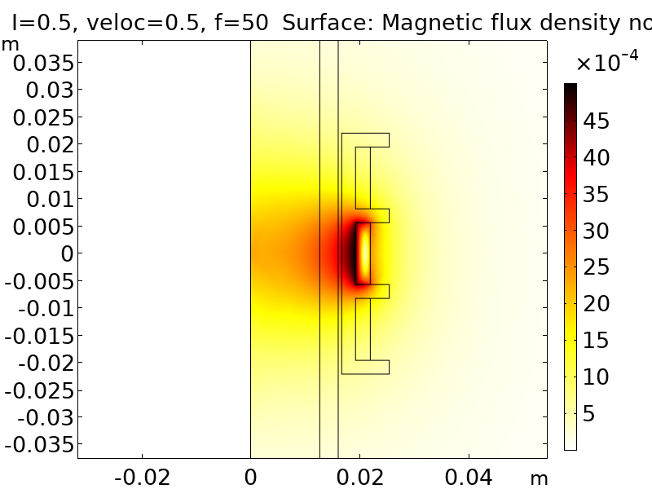
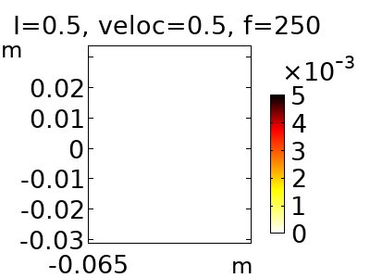
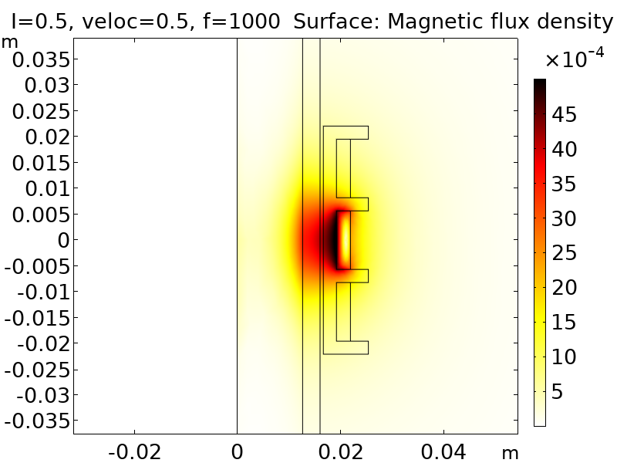
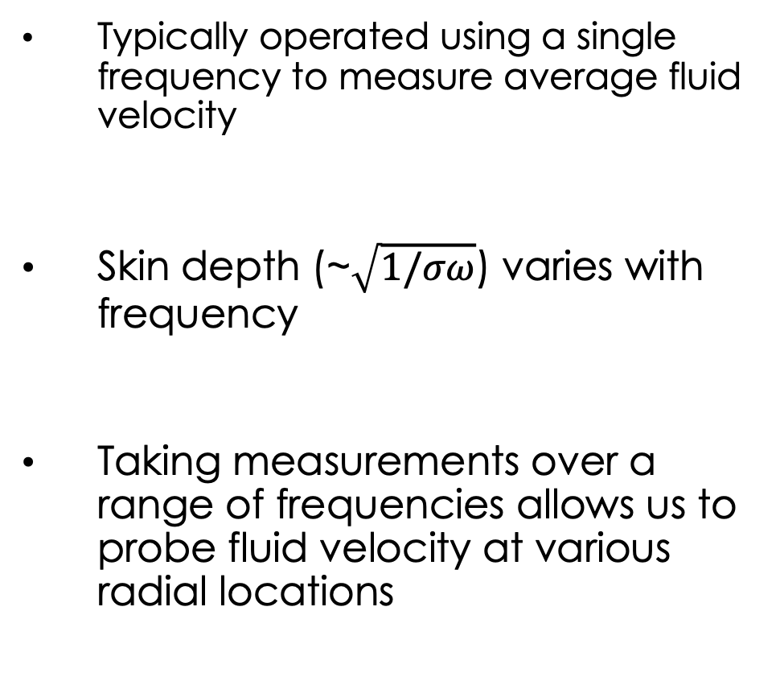
Expansion of ECFM capabilities
AC
magnetic field
Typically operated using a single frequency to measure average fluid velocity
Skin depth (~$\sqrt{1/σω}$) varies with frequency
Taking measurements over a range of frequencies allows us to probe fluid velocity at various radial locations
50 Hz
a)
1000 Hz
b)
500 mA, 0.5 m/s, aluminum rod, bobbin #1, PVC pipe

Slide 7


ECFM plan for this project
Funded by Versatile Test Reactor (VTR) project to eventually measure flows in liquid lead and sodium fission reactor
Project goal is to determine if ECFM models match experiments for a wide range of parameters and can we obtain flow profile and not just mean flows to increase measurement capability
Project plan designed in increasing complexity in both technical (temperature and corrosion) and cost aspects
Finite element model development
ECFM model validation in a moving dry rod
Flow-through ECFM model validation in liquid mercury
Insertable ECFM probe model validation in liquid mercury
Flow-through ECFM model validation in liquid sodium and lead
Insertable ECFM model validation in liquid sodium and lead

Slide 8
Outline of today’s talk
Motivation and introduction to this eddy current flow meter (ECFM) project
Modeling setup for velocity profile prediction from ECFM measurements and model validation.
Brief overview of Experimental Setup
Model verification and validation results

Slide 9
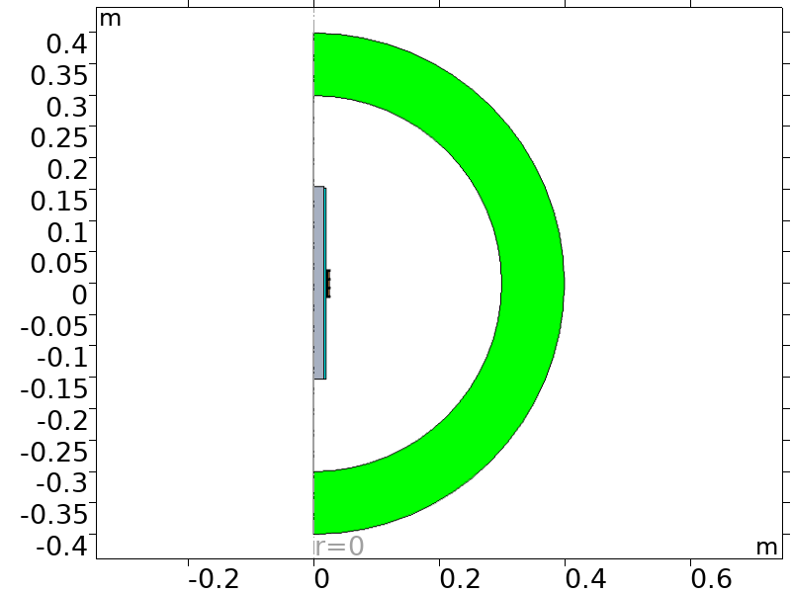
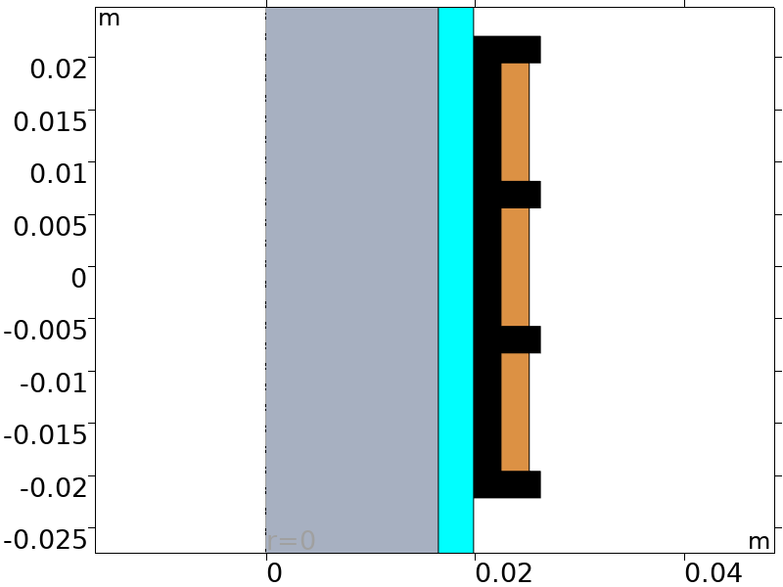
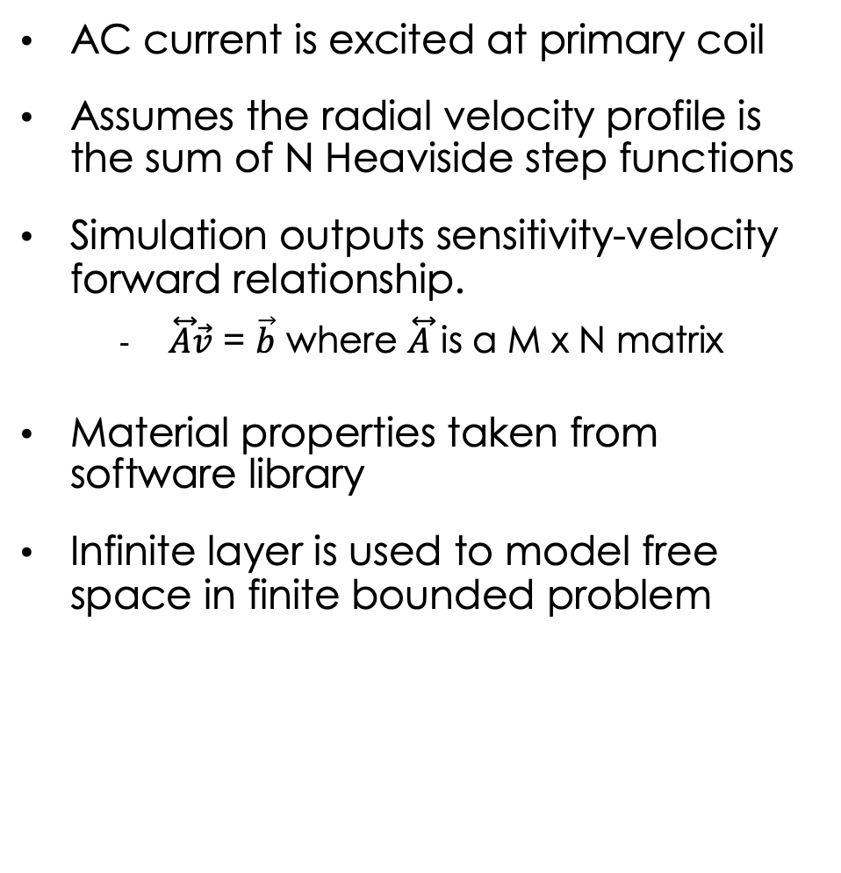
2-D axisymmetric Ampere’s law Simulation
AC current is excited at primary coil
Assumes the radial velocity profile is the sum of N Heaviside step functions
Simulation outputs sensitivity-velocity forward relationship.
$\overset{⃡}{A}\vec{v}$ = $\vec{b}$ where $\overset{⃡}{A}$ is a M x N matrix
Material properties taken from software library
Infinite layer is used to model free space in finite bounded problem
Infinite
Layer
Air
Axis of rotation
Secondary
coil
Primary
coil
Secondary
coil
Bobbin
Pipe
Liquid metal

Slide 10
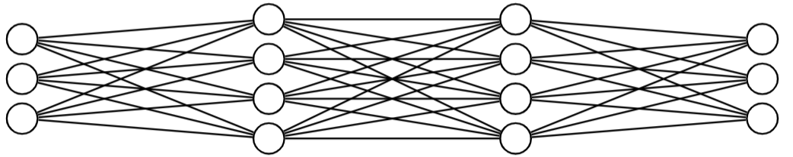
Deep Neural Network (DNN) to solve $\vec{v}$ = ${\overset{⃡}{A}}^{−1}\vec{b}$
Traditional techniques are in efficient and unstable in this application
Simulated Annealing, Grid Search, Gradient Descent.
DNNs can provide a a general solution that is more stable.
Once trained DNNs quickly make predictions on large data sets.
Representation of DNN Model
Profile Type | Inputs | Hidden Layers | Nodes Per Layer | Outputs
Parabolic | 26 | 2 | 100 | 7
Power Law | 26 | 2 | 100 | 7
Monotonic | 26 | 3 | 100 | 7
Table of Model Parameters

Slide 11
Uncertainty/Stability Quantification
Import for understanding model stability and to simulate real world performance
Monte Carlo Method was used, putting 5% random noise on sensitivity inputs.
Done 1000 times for measured input and RMSE was calculated
No noise was added to phase measurements. Very low error in those measurements

Slide 12
2-D axisymmetric Navier Stokes equation is used for liquid metal
incompressible, turbulent Navier Stokes equation used to calculate liquid metal flow
Reynold’s number > 20000 > critical Reynold’s number ~ 2300
k-ε RANS turbulence incompressible swirl flow model
No surface roughness or gravity
3-D model was also done, not shown today in interest of time
Inflow
Velocity
BC
Outflow
Pressure
BC
No slip BC
Axis of rotation
Secondary
coil
Primary
coil
Secondary
coil
Bobbin
Pipe
Liquid metal

Slide 13
Outline of today’s talk
Motivation and introduction to this eddy current flow meter (ECFM) project
Modeling setup for velocity profile prediction from ECFM measurements and model validation.
Brief overview of Experimental Setup
Model verification and validation results

Slide 14
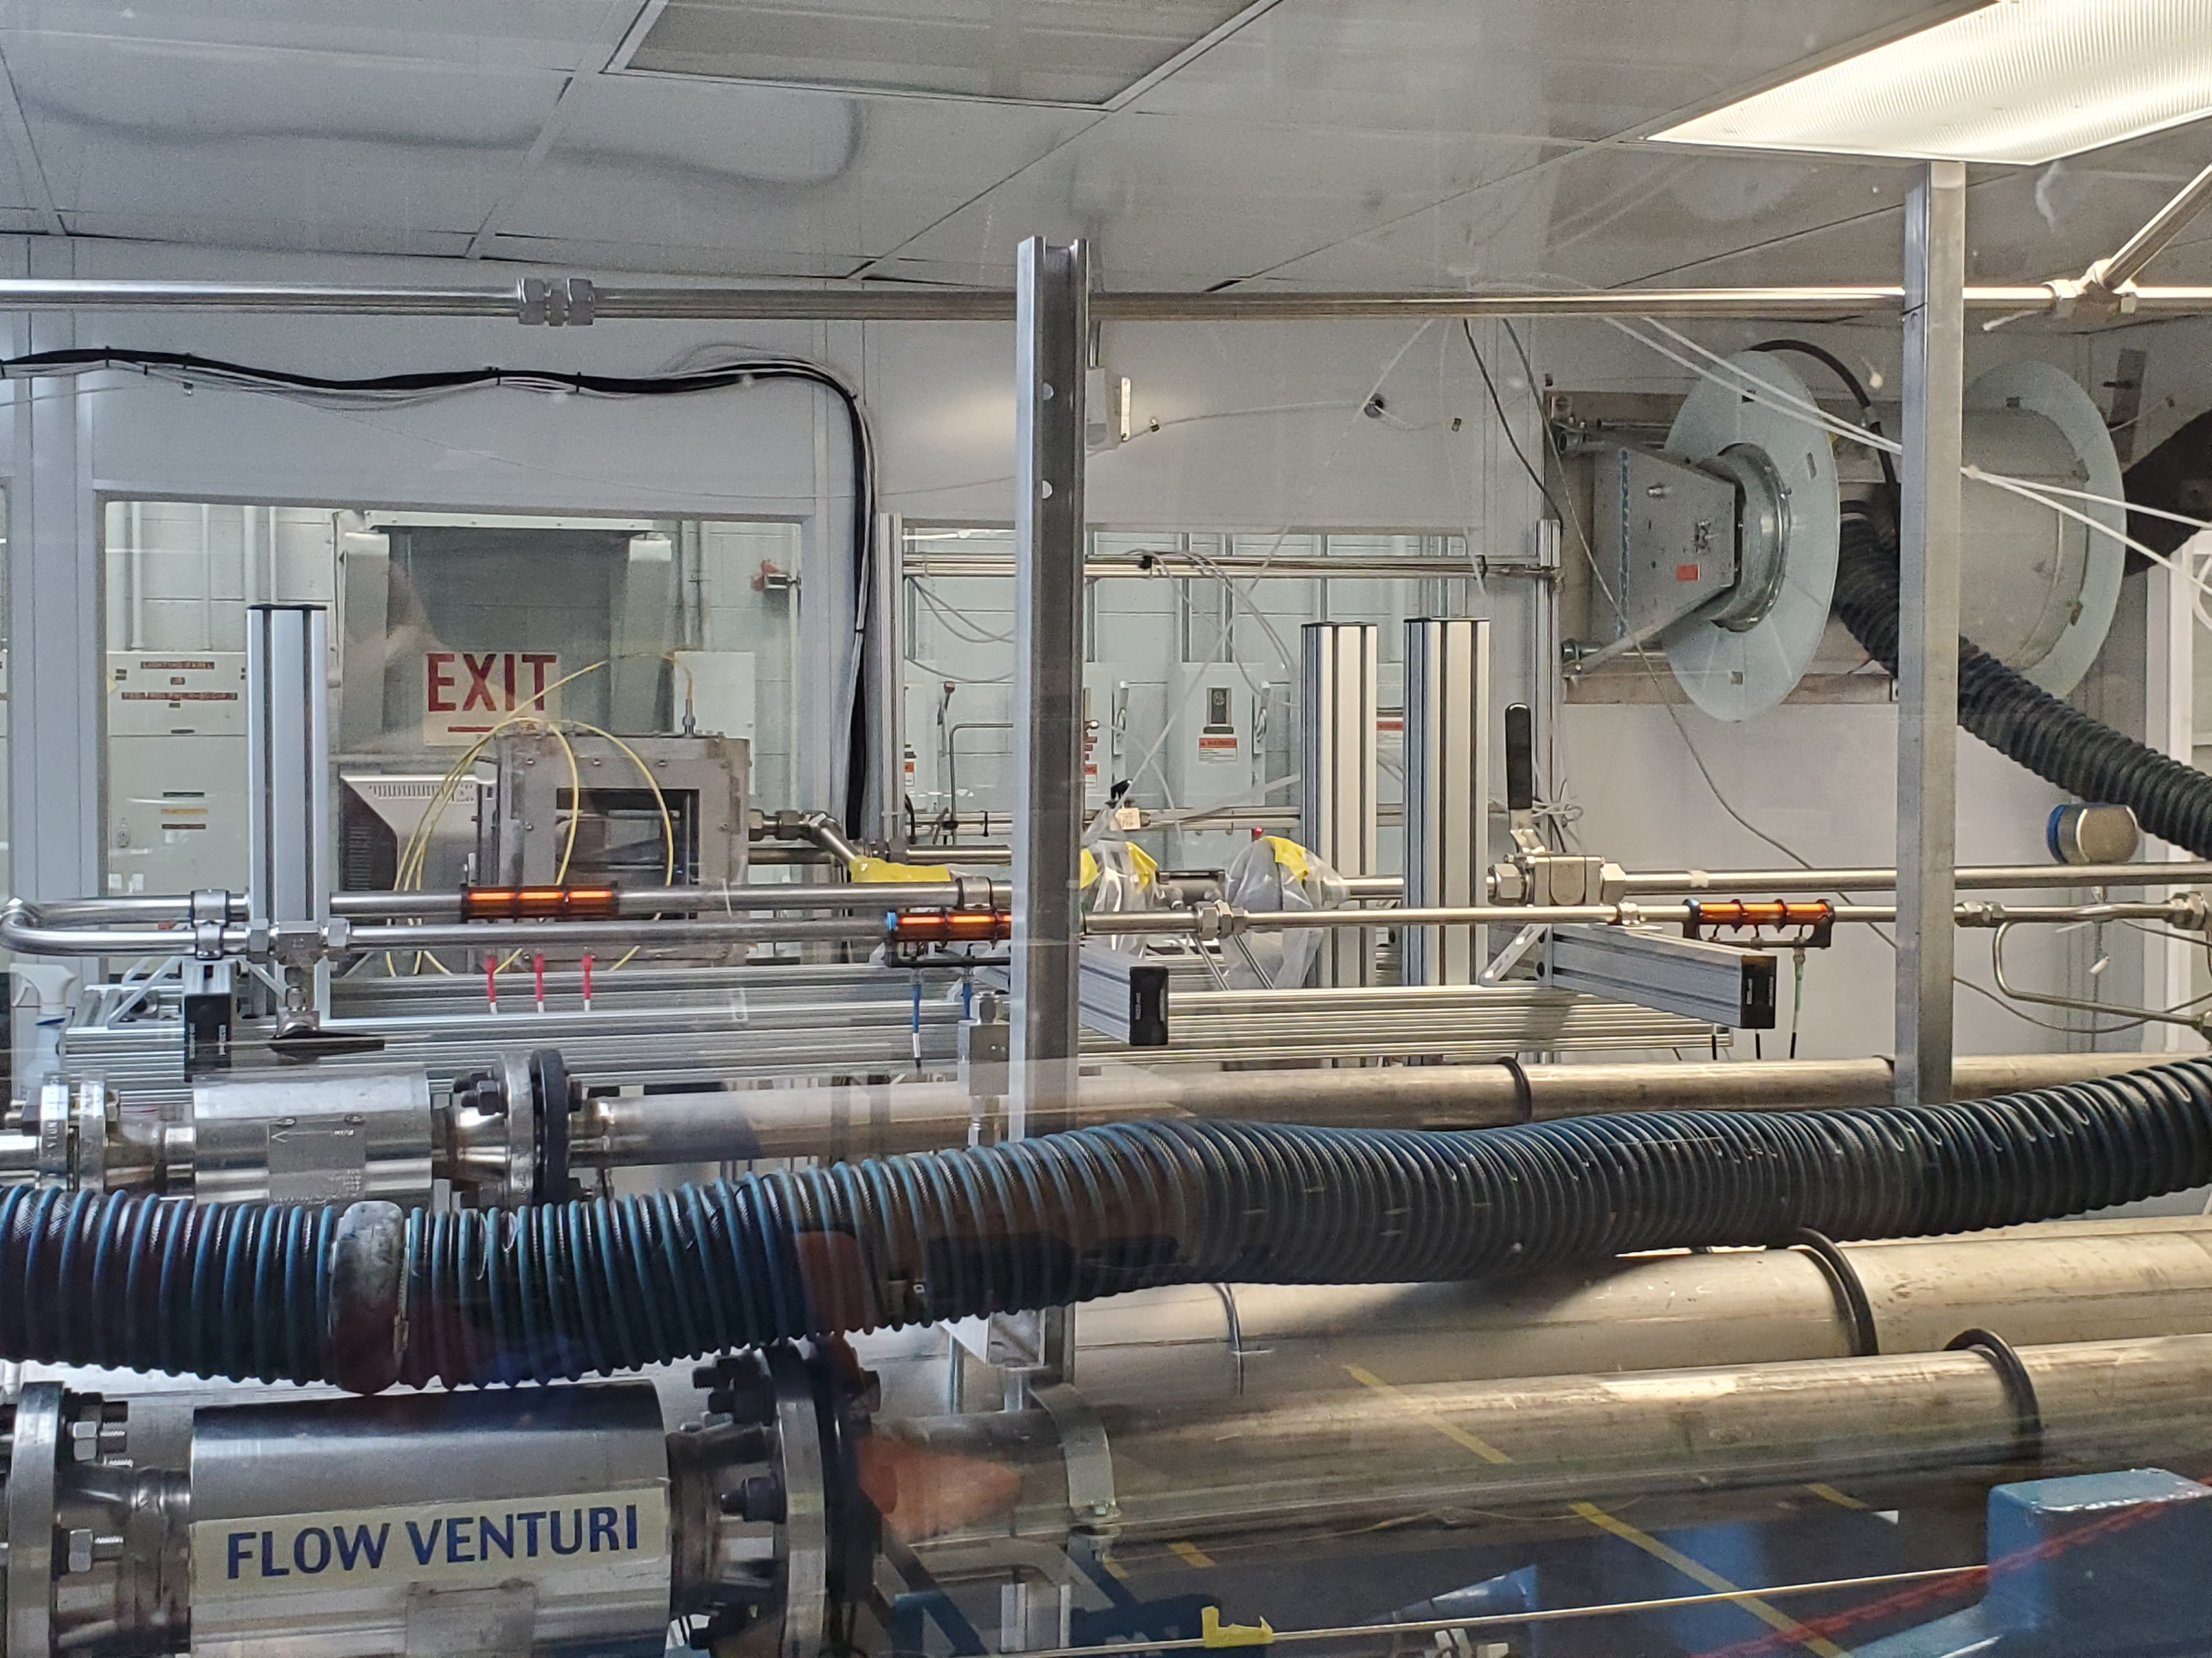
ECFM experimental setup for liquid mercury
Target Test Facility is a full-scale replica of SNS Target Cell mercury flow loop and contains 1.4 cubic meters of mercury weighing approximately 42000 pounds
ECFM flow test stand built as an addition to Target Test Facility for flow validation
Inlet flow is measured using v-cone flow meter
Cables run from sensor to ECFM electronics outside enclosure
V-cone flow meter
Flow in
1.25” sensor
Flow out
1” sensor
0.75” sensor

Slide 15
Outline of today’s talk
Motivation and introduction to this eddy current flow meter (ECFM) project
Modeling setup for velocity profile prediction from ECFM measurements and model validation.
Overview of Experimental Setup
Model verification and validation results

Slide 16
Model Verification and Validation setup
Each model was trained using a set of ~2,000,000 randomly generated flow profiles of their corresponding type.
After training a new set of 128 randomly generated flow profiles was used for model Verification
Model Validation was done using experimentally measured sensitivity magnitudes and phases and compared to CFD simulated velocity profile
Using the measured ECFM sensitivity the Monte Carlo Method was used to quantify uncertainty and model stability

Slide 17
Parabolic Model Verification

Slide 18
Power Law Model Verification

Slide 19
Monotonically Decreasing Model Verification

Slide 20
Model Verification and Validation setup
Each model was trained using a set of ~2,000,000 randomly generated flow profiles of their corresponding type.
After training a new set of 128 randomly generated flow profiles was used for model Verification
Model Validation was done using experimentally measured sensitivity magnitudes and phases and compared to CFD simulated velocity profile
Using the measured ECFM sensitivity the Monte Carlo Method was used to quantify uncertainty and model stability

Slide 21
Measured versus Simulated Inputs

Slide 22
Parabolic Model Validation
Component | 0 | 1 | 2 | 3 | 4 | 5 | 6
MAE [m/s] | 0.07 | 0.01 | 0.00 | 0.04 | 0.01 | 0.01 | 0.01
NMAE [%] | 5 | 1 | 0 | 4 | 1 | 2 | 1
Table of Errors in DNN vs CFD model
Component | 0 | 1 | 2 | 3 | 4 | 5 | 6
RMSE [m/s] | 0.09 | 0.04 | 0.03 | 0.05 | 0.02 | 0.02 | 0.02
NRMSE [%] | 7 | 3 | 2 | 4 | 2 | 2 | 2
Table of errors in DNN with Noise vs CFD model

Slide 23
Power Model Validation
Component | 0 | 1 | 2 | 3 | 4 | 5 | 6
MAE [m/s] | 0.04 | 0.01 | 0.00 | 0.00 | 0.00 | 0.02 | 0.05
NMAE [%] | 3 | 1 | 0 | 0 | 0 | 2 | 5
Table of Errors in DNN vs CFD model
Component | 0 | 1 | 2 | 3 | 4 | 5 | 6
RMSE [m/s] | 0.05 | 0.03 | 0.02 | 0.02 | 0.02 | 0.03 | 0.05
NRMSE [%] | 4 | 2 | 2 | 2 | 2 | 2 | 4
Table of errors in DNN with Noise vs CFD model

Slide 24
Power Model Validation
Component | 0 | 1 | 2 | 3 | 4 | 5 | 6
MAE [m/s] | 0.03 | 0.01 | 0.00 | 0.02 | 0.00 | 0.00 | 0.01
NMAE [%] | 2 | 1 | 0 | 1 | 0 | 0 | 1
Table of Errors in DNN vs CFD model
Component | 0 | 1 | 2 | 3 | 4 | 5 | 6
RMSE [m/s] | 0.12 | 0.07 | 0.04 | 0.04 | 0.02 | 0.02 | 0.05
NRMSE [%] | 10 | 5 | 3 | 3 | 2 | 2 | 4
Table of errors in DNN with Noise vs CFD model

Slide 25
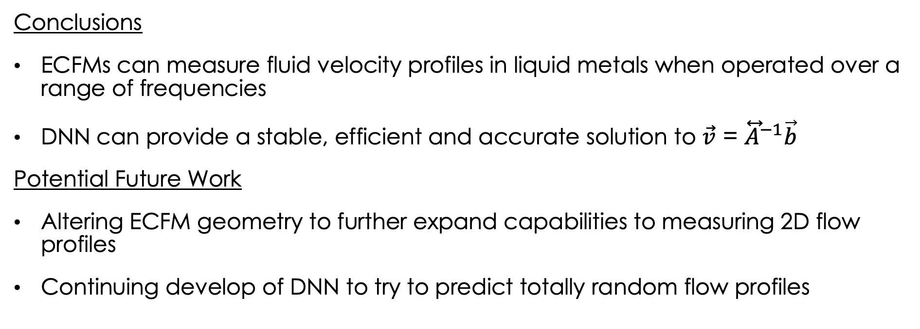
Conclusions and Potential Future Work
Conclusions
ECFMs can measure fluid velocity profiles in liquid metals when operated over a range of frequencies
DNN can provide a stable, efficient and accurate solution to $\vec{v}$ = ${\overset{⃡}{A}}^{−1}\vec{b}$
Potential Future Work
Altering ECFM geometry to further expand capabilities to measuring 2D flow profiles
Continuing develop of DNN to try to predict totally random flow profiles

